Slide 1

GeoNetwork
DCAT-AP schema-plug-in
GeoNetwork Gebruikersgroep Nederland
3 October 2018
Geraldine Nolf, Dirk De Baere, Mathias De Schrijver, Bart Cosyn
Gustaaf Vandeboel, Mathieu Van Wambeke, Mathieu Chaussier, An Heirman, Stijn Goedertier

Slide 2

Information
?
Docu ments
Open
Geo
…

Slide 3




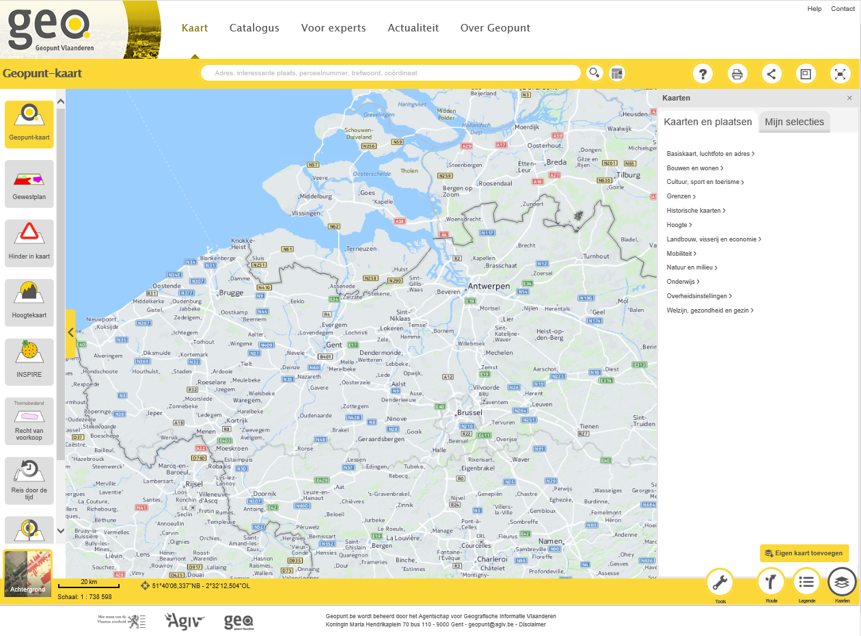
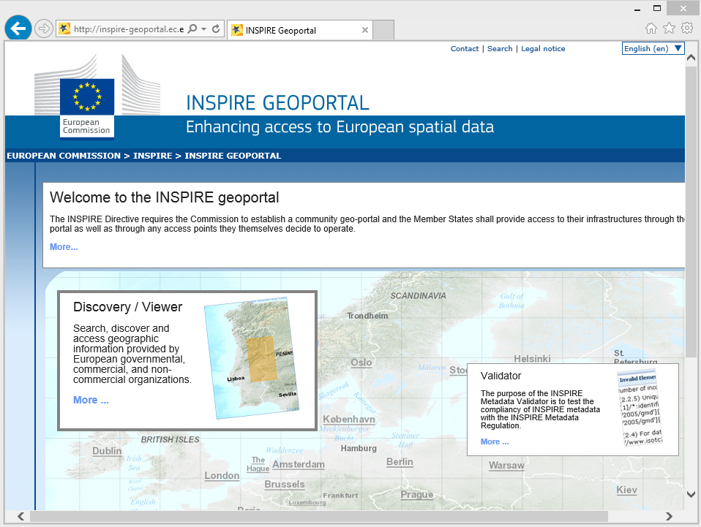


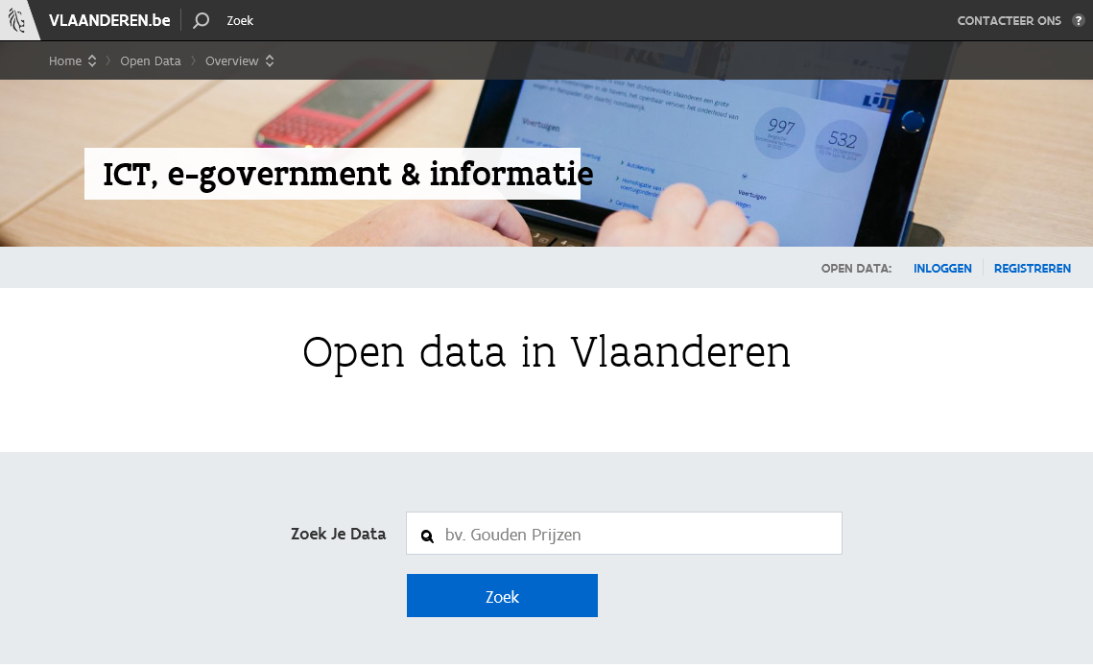
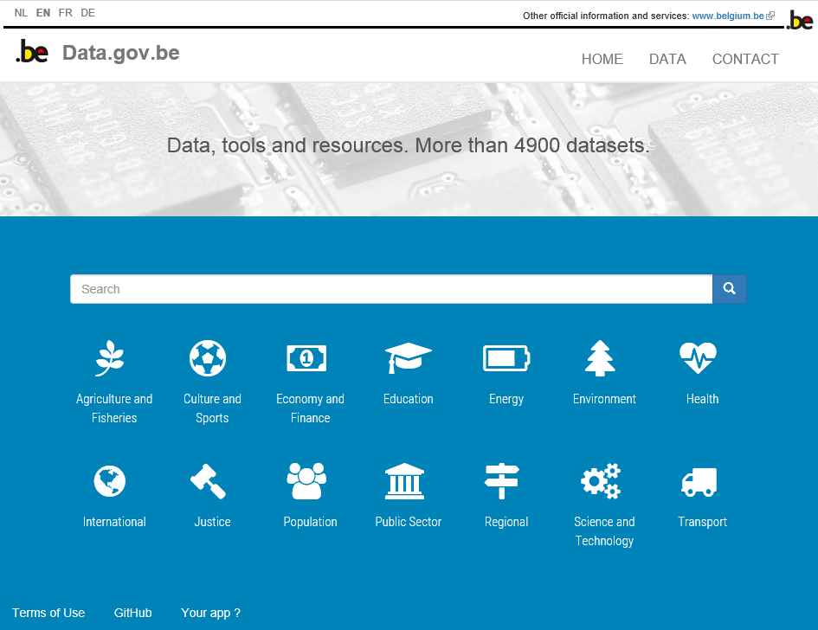
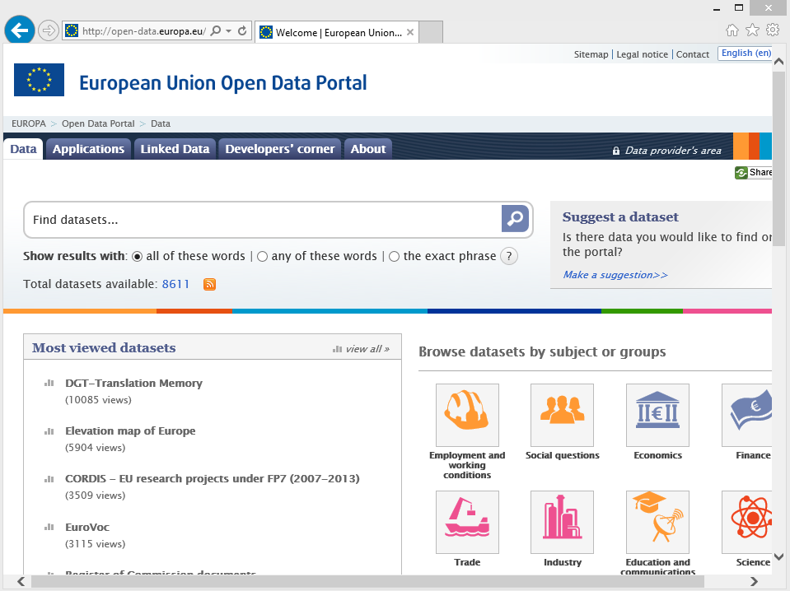




AS IS: METADATA STANDARDS, SYSTEMS, PORTALS
LEVEL: Flanders Belgian European
Standards:
Systems:
Portals:
GEO
Open Geo
Systems:
Portals:
OPEN
Standards:

Slide 4



Overview study
Geographic data & services
ISO/INSPIRE
GeoNetwork
Open data
DCAT
CKAN/TDT
Documents
ISAD(G)-AP EAD PREMIS
(to be)
Geopunt
CKAN
(to be)
…
…
…
…
Data/Services
Data
Documents
…
Study
Metadata Standard
Metadata Management System
Publication via
Portal / Catalogue
Data / Information
Scope Information Catalogue

Slide 5
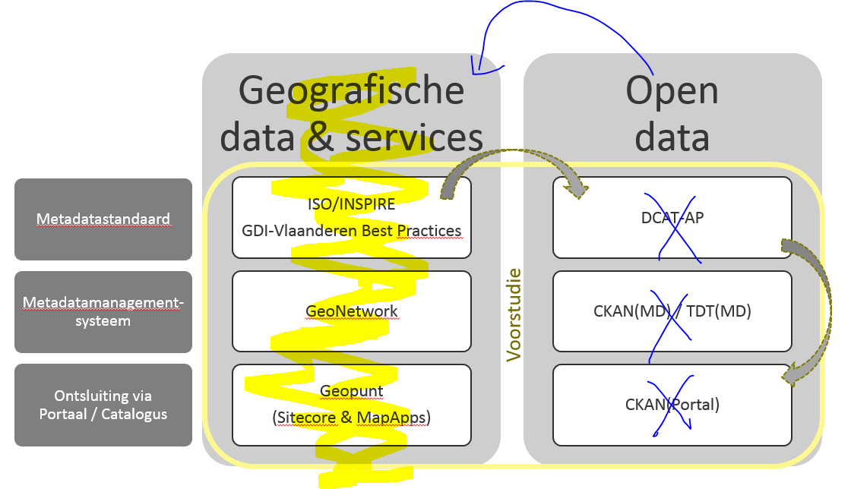
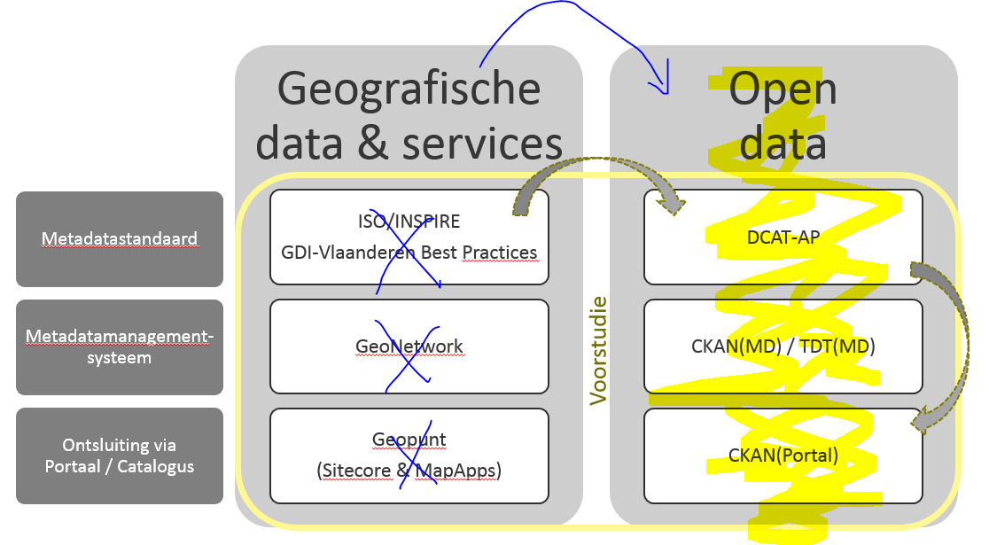
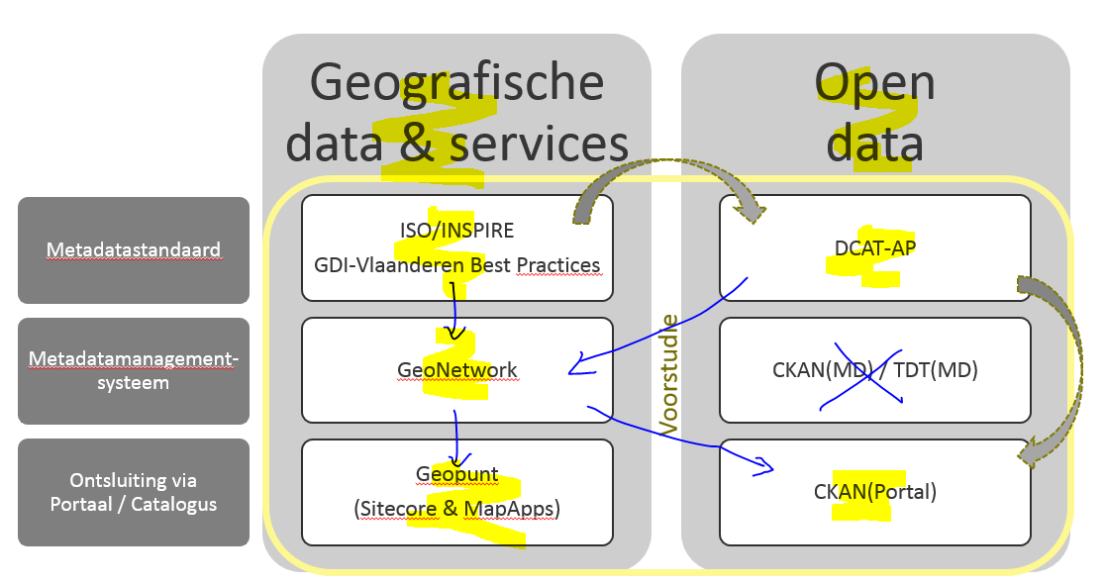
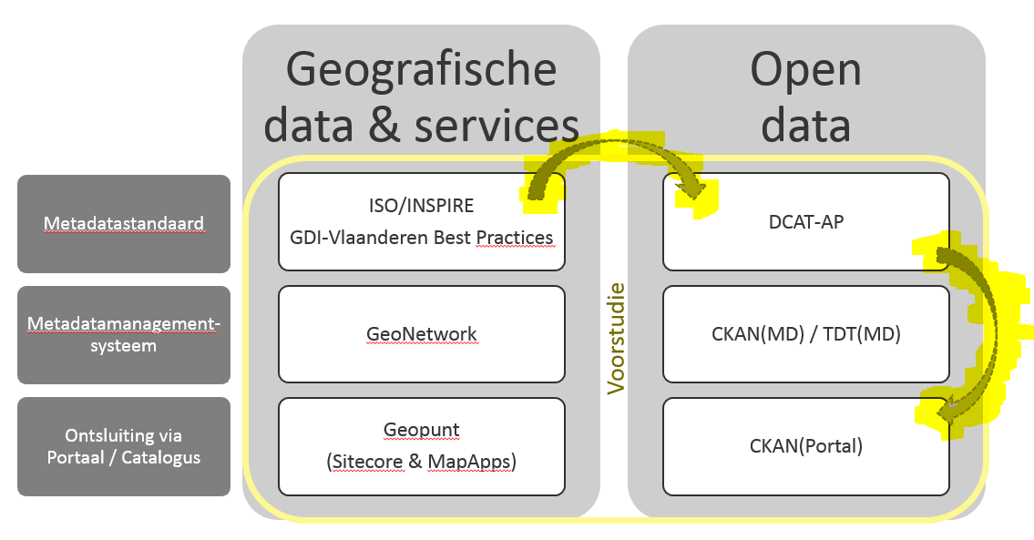


Study: Scenarios
Scenario 0: Optimize & automate AS IS
Scenario 1: Open via procedures Geo domain
Scenario 2: Geo via procedures Open data domain
Scenario 3: Mixed Scenario

Slide 6
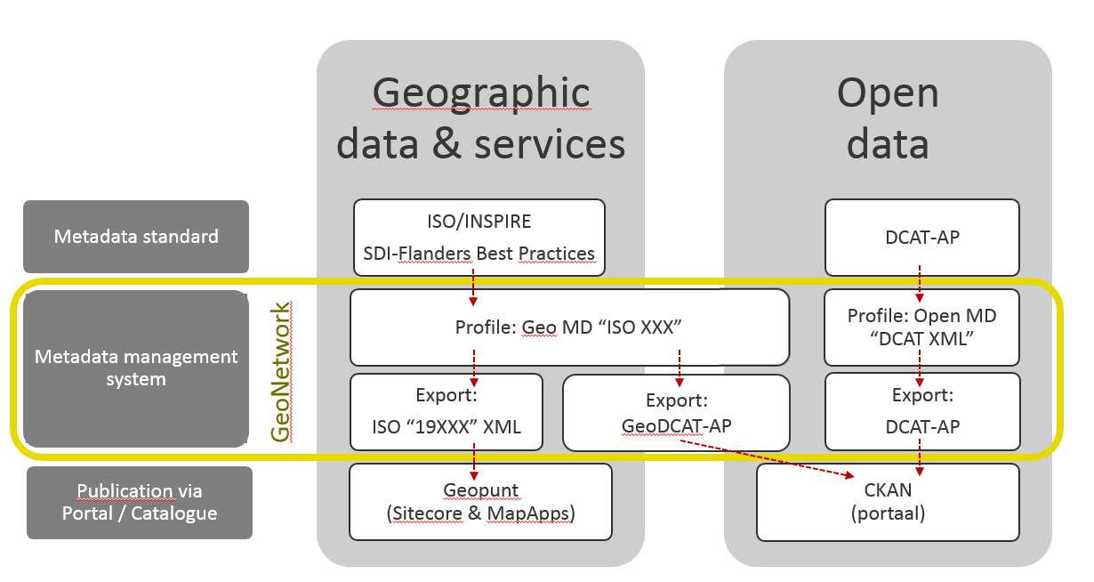
Results on the study between Geo & Open data domains

Slide 7
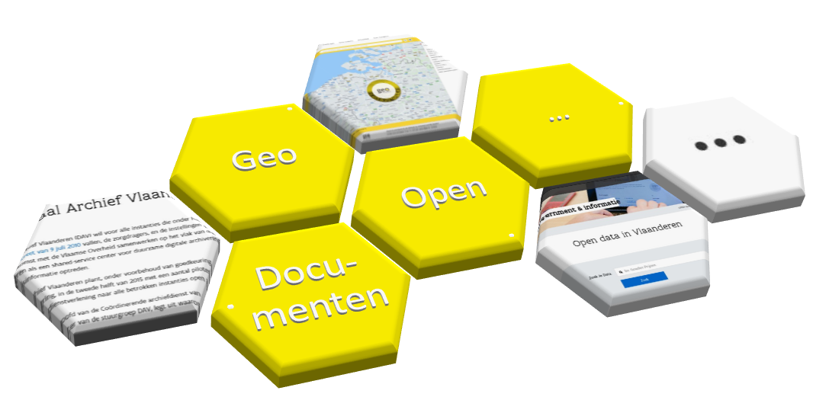
“Informatiecatalogus”
Informatie
catalogus
GeoNetwork - DCAT-AP schema-plug-in - 2018 October 3rd
7

Slide 8
Scope “Informatiecatalogus”
Geografic data & services
ISO/INSPIRE
GeoNetwork
Open
data
DCAT
CKAN/TDT GeoNetwork
Documents
EAD
(to be – GeoNetwork ?)
Geopunt
CKAN
(to be)
Data/Services
Data
Documents
Personal & Company data
Services
API’s
(to be - DCAT ?)
(to be - Apigee ?)
…
Images
…
…
…
Images
Infographics
…
…
…
Standards
Codelists
…
…
…
Codelists
Standards
API’s
(to be – DCAT ?)
(to be – GeoNetwork ?)
MAGDA-online
Data/Services
Statistic data & services
SDMX / StatDCAT ?
(to be – GenoNetwork ?)
(to be)
Statistics/Services
Scope 1
Metadata Standard
Metadata Management System
Publication via
Portal / Catalogue
Data / Information
Scope Information Catalogue

Slide 9
DCAT: a W3C recommendation
W3C Recommendation since 16 January 2014.
https://www.w3.org/TR/vocab-dcat/
Makes use of terms defined in foundational vocabularies such as Dublin Core, FOAF, etc. but also defines its own terms in a namespace: http://www.w3.org/ns/dcat#

Slide 10
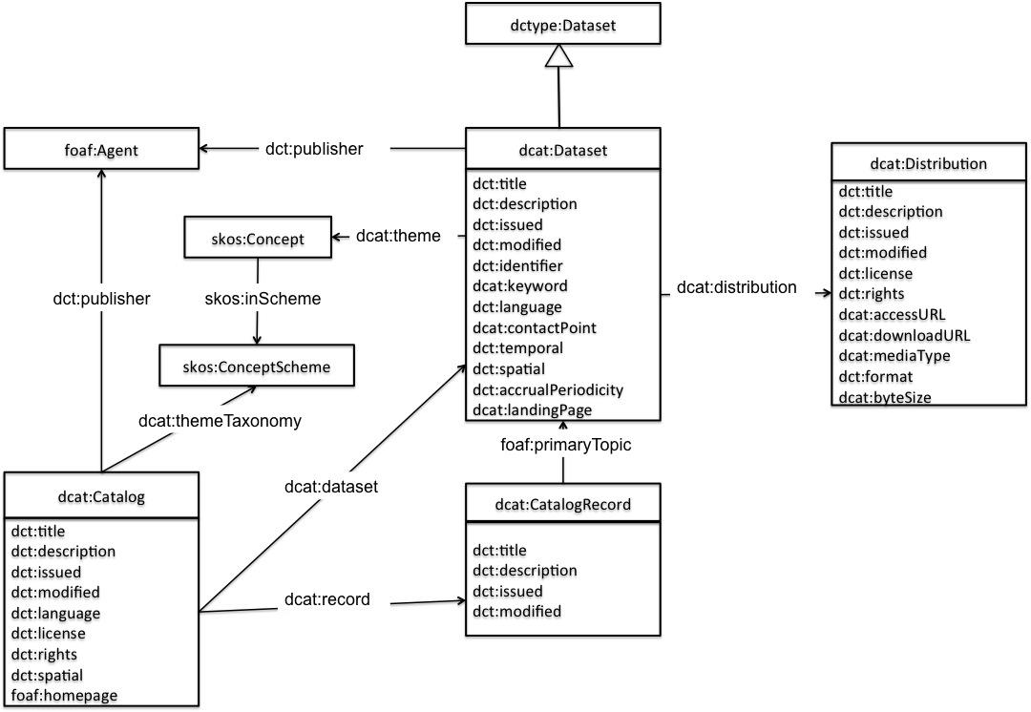
DCAT: a W3C recommendation

Slide 11
DCAT-AP v1.1: an application profile of DCAT for data portals in Europe
Conforms with DCAT
https://joinup.ec.europa.eu/release/dcat-ap-v11
Extends DCAT with additional terms and properties
Imposes mandatory, recommended, and optional classes and properties
Imposes controlled vocabularies

Slide 12
GeoDCAT-AP
Maakt geografische datasets, datasetseries en services doorzoekbaar op generieke dataportalen, daarbij wordt geografische data beter vindbaar over grenzen en sectoren heen.
Verkregen door het uitwisselen van beschrijvingen van datasets onder dataportalen.
Vervangt niet:
  INSPIRE Metadata Regulation
  INSPIRE Metadata Technical Guidelines based on ISO19115 and ISO19119
Geeft eigenaars van geografische data de mogelijkheid om meer te bereiken dan met DCAT(-AP) omwille van extra RDF syntax (opnieuw hergebruik van bestaande vocabularia – geen nieuwe terminologie)

Slide 13
GeoNetwork: schema plugin architecture
Via schema plugins GeoNetwork can be extended to support other metadata standards
Examples: ISO19139, ISO19115-3, ISO19110, SensorML, … https://github.com/metadata101
Plugins are an additional directory with:
  XML Schema
  XML configuration (forms)
  XSLT: forms, post-processing, index-fields, conversion, etc
  schematron validation rules (optional)
  Java code: e.g. harvester (optional)
  Metadata template / sample-data (optional)
  …
Notes:
A schema plugin that can be used in GeoNetwork is a directory of stylesheets, XML schema descriptions (XSDs) and other information necessary for GeoNetwork to index, view and possibly edit content from XML metadata records.

Slide 14
DCAT-AP Schema plugin
Based on DCAT-AP v1.1
Funded and managed by Informatie Vlaanderen
Beta environment:
  http://beta.metadata.vlaanderen.be/geonetwork
Will be released as open-source software (GPLv2 license)
  https://github.com/metadata101/dcat-ap1.1

Slide 15
DCAT-AP XML Schema: a “normalised” XML Schema for DCAT-AP
XML is a nested data structure that can be queried with Xpath, Xquery, XSLT, …
RDF is a graph-based data structure that can be queried with SPARQL. The RDF/XML serialisation of RDF can be arbitrarily structured.
GeoNetwork can only process XML-based metadata.
So, an XML Schema must be defined.
XSLT
SPARQL CONSTRUCT
DCAT-AP XML
DCAT-AP RDF
normalised
DCAT-XML
DCAT-RDF records

Slide 16
DCAT-AP XML Schema: design choices
More restrictive than DCAT-RDF
Any document that is valid according to DCAT-XML is valid according to DCAT-RDF
Sequence and nesting:
  dcat:Catalog
    dcat:Dataset,
      dcat:Distribution
dct:LicenseDocument as sub-templates
dct:language (dct:LinguisticDocument), dcat:theme (skos:Concept), dct:accrualPeriodicity (dct: … as thesauri (skos:Concept)
multilingualism

Slide 17
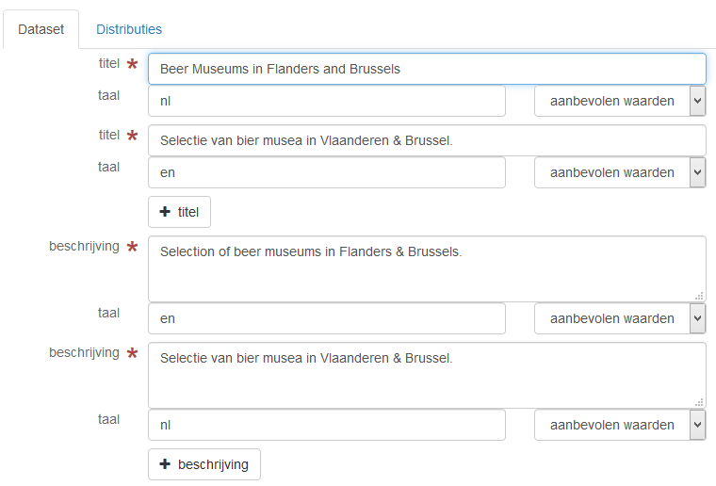
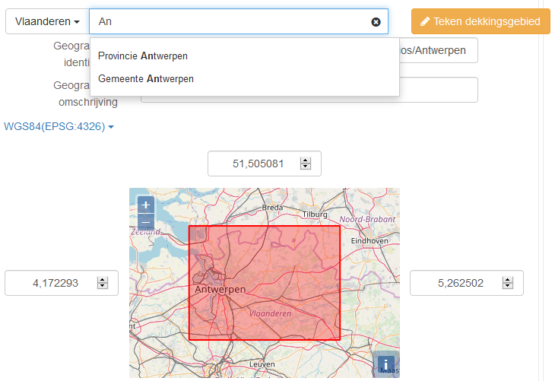
DCAT-AP editor
Simple and advanced form
Multilingual
Controlled vocabularies as thesauri
Reuse (with modification) of existing controls (e.g. spatial extent)

Slide 18
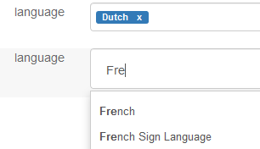
Controlled vocabularies
The plugin will include the DCAT-AP v1.1 controlled vocabularies as GeoNetwork thesauri (SKOS)
  <dct:language>
  <skos:Concept rdf:about="http://publications.europa.eu/resource/authority/language/NLD">
  <rdf:type rdf:resource="dct:LinguisticSystem"/>
  <skos:prefLabel xml:lang="nl">Nederlands</skos:prefLabel>
  <skos:prefLabel xml:lang="en">Dutch</skos:prefLabel>
  <skos:prefLabel xml:lang="fr">néerlandais</skos:prefLabel>
  <skos:prefLabel xml:lang="de">Niederländisch</skos:prefLabel>
  <skos:inScheme rdf:resource="http://publications.europa.eu/resource/authority/language"/>
  </skos:Concept>
  </dct:language>

Slide 19
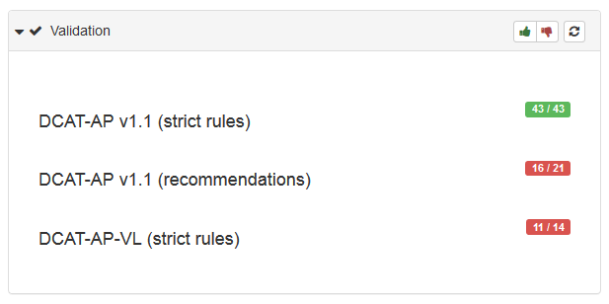
Validation
DCAT-AP integrity constraints have been transformed into a three schematron rulesets:
  DCAT-AP v1.1 strict rules
  DCAT-AP v1.1 recommendations
  DCAT-AP-VL strict rules

Slide 20
RDF endpoint
Standard GeoNetwork API
  Reuse of Lucene search parameters
Follows recommendations by W3C LDP Paging
Example: http://beta.metadata.vlaanderen.be/geonetwork/srv/api/0.1/records?from=1&hitsPerPage=10&any=beer

Slide 21
DCAT harvester
XML is a nested data structure that can be queried with Xpath, Xquery, XSLT, …
RDF is a graph-based data structure that can be queried with SPARQL. The RDF/XML serialisation of RDF can be arbitrarily structured.
GeoNetwork can only process XML-based metadata.
On import, DCAT-RDF metadata must be “normalised”
XSLT
SPARQL CONSTRUCT
DCAT-XML
SPARQL SELECT +
XSLT
DCAT-RDF
XSLT (trivial)
normalised
DCAT-XML
DCAT-AP records

Slide 22
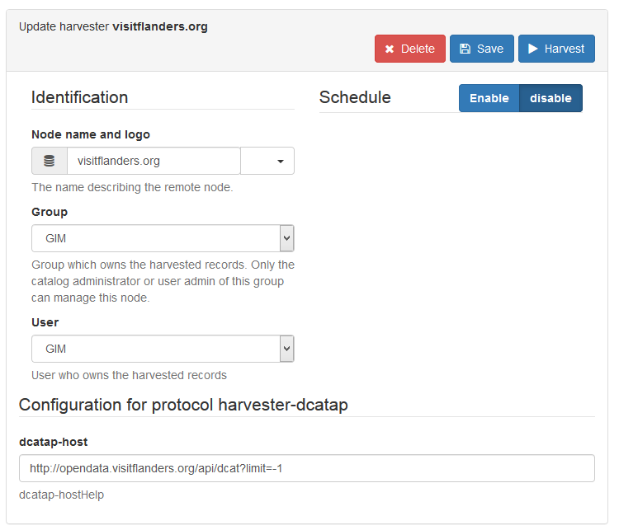
DCAT harvester
Turtle, RDF/XML, N3, JSON-LD syntax
No paging support so far (not needed)

Slide 23
Room for improvement
Usability of the forms
Usability of validator (link with fields)
Harvester with paging support
Schema.org integration (JSON.LD on HTML pages)
Look & feel

Slide 24
Contact?
geraldine.nolf@kb.vlaanderen.be
stijn.goedertier@gim.be

